Slide 1

Rationale
Introduction to Windows Store App Development Using HTML5 and JavaScript
Computer science is a field of study that deals with solving a variety of problems by using computers.
  To solve a given problem by using computers, you need to design an algorithm for it.
Multiple algorithms can be designed to solve a particular problem.
An algorithm that provides the maximum efficiency should be used for solving the problem.
  The efficiency of an algorithm can be improved by using an appropriate data structure.
Data structures help in creating programs that are simple, reusable, and easy to maintain.
This module will enable a learner to select and implement an appropriate data structure and algorithm to solve a given programming problem.

Slide 2
Objectives
  In this session, you will learn to:
  Implement data binding
  Use data templates for displaying data
Notes:
2

Slide 3
Using Data/ Collection Controls (Contd.)
  The FlipView control:
  Can be used to display a collection of items, usually images.
  Can be added to an app by using the <div> tag and specifying its data-win-control property as WinJS.UI.FlipView.
  Can be customized by using the various properties, such as:
    currentPage
    itemDataSource
    itemTemplate
    orientation
Let us look at an example, which demonstrates the use of data/ collection controls
Notes:
3
Explain the parameters of the syntax.

Slide 4
Demo: Binding UI Elements with Data
  Problem Statement:
  Nancy is working as an app developer in Global Tech Inc. She has been assigned a task to develop an app that generates preformatted greeting cards. The Greeting Card app accepts the following inputs from the user:
    Name of the recipient
    Type of the event
    Message
    Name of the sender
  In addition, a button is provided on the UI to generate the greeting card. The card is generated based on the inputs provided by the user.
Notes:
4

Slide 5
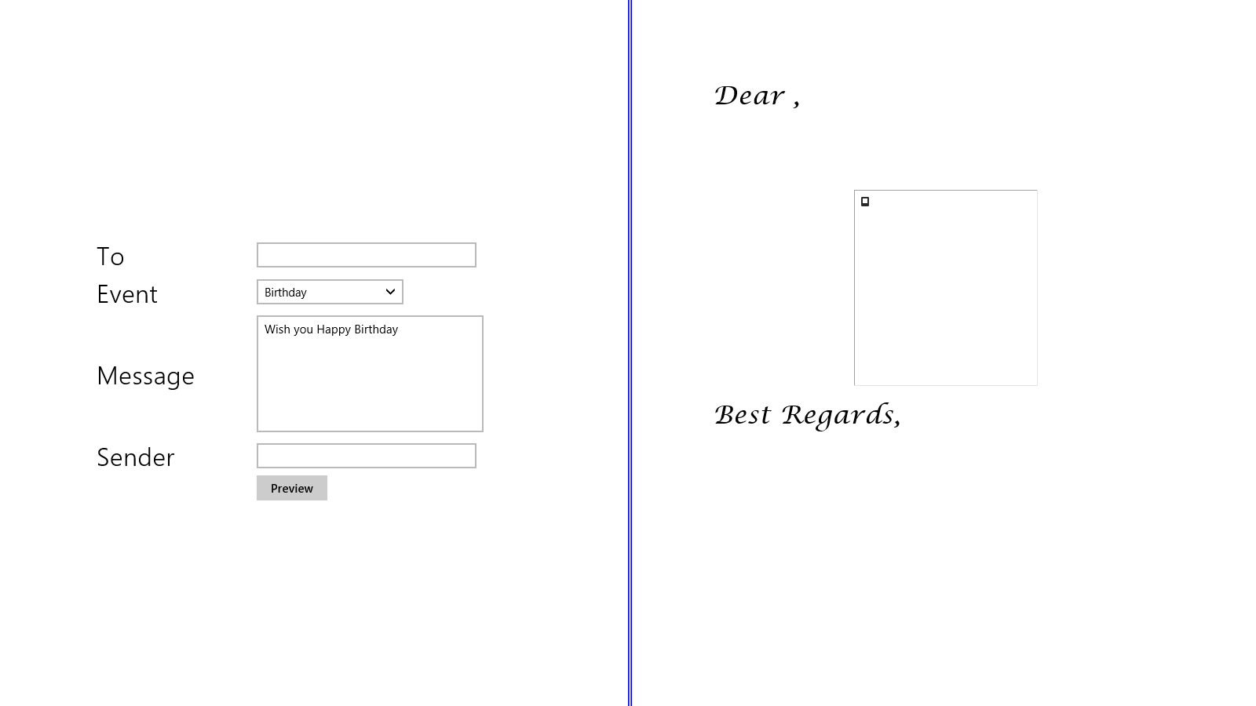
Demo: Binding UI Elements with Data (Contd.)
    As an initial step, Nancy creates the UI of the Greeting Card app, as shown in the following figure.
    Now, she wants to implement a set of functionality that allows users to:
      Provide the recipient's name.
      Select the event type.
      Edit the predefined message for the selected event.
Notes:
5

Slide 6
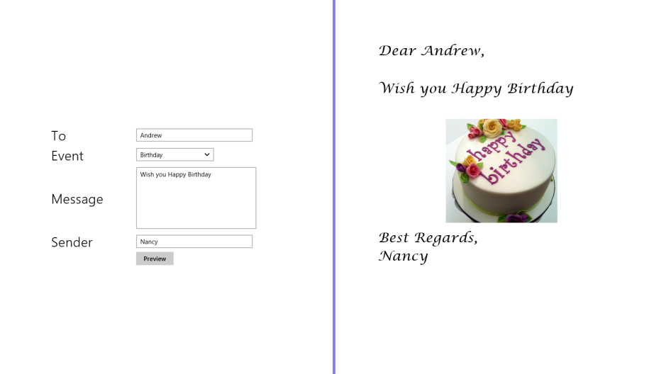
Demo: Binding UI Elements with Data (Contd.)
      Provide the sender's name.
    Once a user provides the preceding details and clicks the Preview button, the preview of the card is displayed in the right pane, as shown in the following figure.
    Help Nancy to accomplish the preceding task.
Notes:
6

Slide 7
Demo: Binding UI Elements with Data (Contd.)
  Solution:
  To implement the required functionality in the app, Nancy needs to perform the following tasks:
    1. Add functionality to the Event drop-down list.
    2. Add functionality to the Preview button.
    3. Execute the app and verify the output.
Notes:
7

Slide 8
Using Data Templates for Displaying Data
To display data in a presentable format, you need to define and use a data template.
Notes:
8

Slide 9
Defining a Data Template
  A data template:
  Describes the visualization and layout of the data to be displayed in a collection control.
  Defines the visual appearance of each element in a data control.
  Ensures consistency in the manner in which a collection control displays different sets of data.
  Can be defined by using the <div> element and setting its data-win-control property to WinJS.Binding.Template.
Notes:
9

Slide 10
Defining a Data Template (Contd.)
  Example:
  <div id="storiesListTemplate"
  data-win-control="WinJS.Binding.Template">
  <!-- Markup to define the layout-->
  ...............
  ...............
  </div>
Notes:
10

Slide 11
Using a Data Template for Displaying Items in a UI Element
  You can use the data template to display items in a
  data/ collection control by:
  Setting the itemTemplate property of the data/ collection control with the identifier of the data template.
  Example:
  <div id="lstViewStoryDetails"
  data-win-control="WinJS.UI.ListView"
  data-win-options="{itemTemplate:
  storiesListTemplate}">
  </div>
Notes:
11

Slide 12
Summary
  In this session, you learned that:
  You can use the FlipView control to display a collection of items, which is usually a collection of images.
  A data template describes the visualization of the data.
  It defines the layout in which the data needs to be displayed in a collection control.
Notes:
12

Slide 13

Q&A

